Slide 1


DATA ANALYTICS PORTFOLIO

Slide 2
PROFESSIONAL BACKGROUND
I am a student pursuing graduation in Bachelors in Computer Science. I have secrued 8.54 CGPA(till 5th sem) and have several skills such as proficiency in various programming languages such as Python, C++ and Java. I also have several other tech skills such as basic knowlege of Machine Learning, Data Analysis and Data science.
I have done various projects, recent being ‘VISUALIZATION AND FORECASTING OF STOCKS USING DASH’ and published a research paper on ‘THE RISE OF ARTIFICAL INTELLIGENCE’ in college documentry of research papers.
Being a fresher, it would be great for me to experience the real challenges of the corporate world and understand how things work. My strenghts are flexible and adaptive habits to learn new things. I have theoretical knowledge. But I am waiting to use my theoretical knowledge in a practical way. Moreover, I believe by putting significant efforts I will learn.

Slide 3


Overview
Data Analytics Process
01
Instagram User Analytics
02
Operation & Metric Ananlytics
03
Hiring Process Ananlytics
04
IMDB Movie Analsis
05
Bank Loan Case Study
06
Impact of Car Features
07
ABC Call Volume Trend
08

Slide 4

DATA ANALYTICS PROCESS
Data Analytics invoves analyzing the raw data to draw meaningful insights and support decision making.
The steps for data analytics problem solving are:
Plan>> Prepare>> Process>> Analyse>> Visualise>> Strategise.

Slide 5
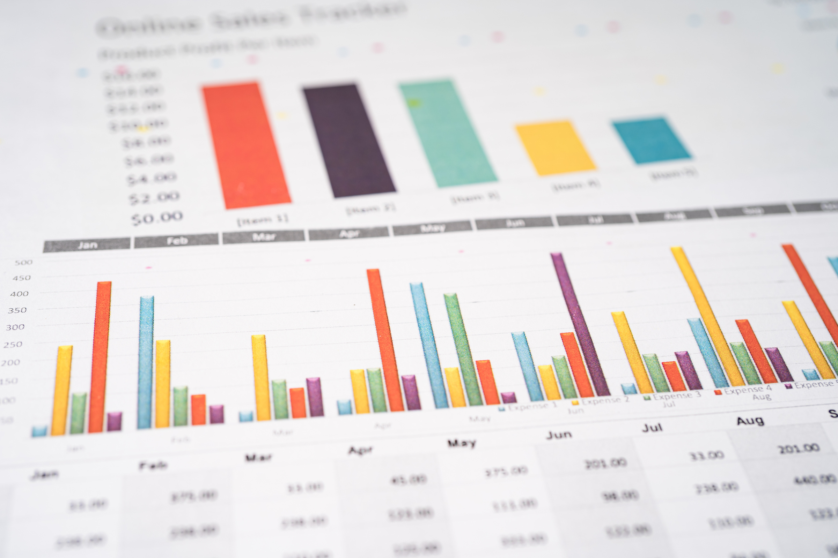


FINDINGS
As a data Analyst, we should be able to identify real-life situations where we use data analytics and link it with the process.
PLAN
PREPARE
PROCESS
Understanding the customer purchasing behaviour to optimise sales and marketing strategies. . This understanding helps in creating personalised experience and improve product offering.
Data Collection: Gathering the data from various sources like transactional data and browsing history.
Data Cleaning: Ensuring accuracy and consistency by handling missing values, outliers and errors.
Data Integration: Combining data from various sources for comprehensive analysis.
Data transformation: Converting data into a suitable format such as flow chatrs and graphs for analysis, ensuring consistency.

Slide 6



ANALYSE
VISUALISE
STRATEGISE
Exploratory Data Analysis (EDA): summarising and visualising data to identify patterns and trends.
Modelling: Using algorithms like clustering and association rule mining for deeper insights.
Visualisation: Creating dashboards and reports to share insights and support decision making.
Also done by creating various charts and plots or flow charts. To make data more readable and approachable.
Translating insights into actionable strategies to achieve business goals such as targeted marketing and product placement optimization.

Slide 7

CONCLUSION
We tend to use data analytics in real life scenarios without even knowing it.

Slide 8

INSTAGRAM USER ANALYTICS
User Analysis is the process by which we can track how users engage with Instagram, in an attempt to drive business insights for marketing and product development.

Slide 9

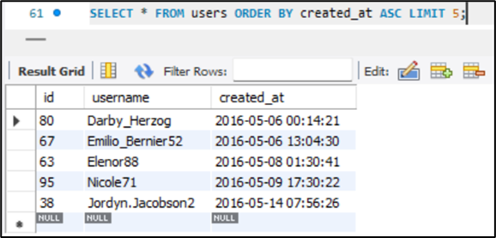
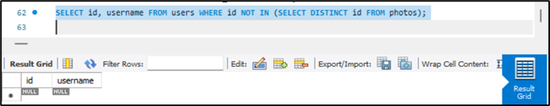
01
LOCAL USER REWARD: Finding the 5 most oldest users of Instagram from the database provided.
INSIGHTS OF MARKETING ANALYSES
02
INACTIVE USER ENGAGEMENT: List users who never posted even a single photo on Instagram.

Slide 10
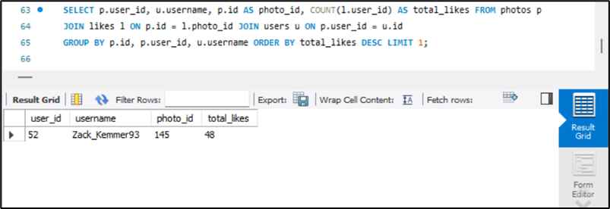
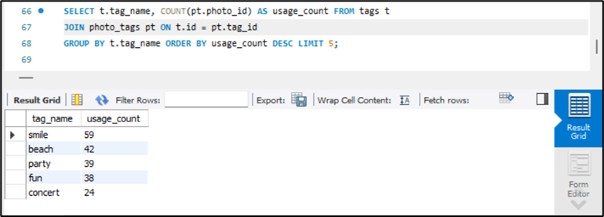
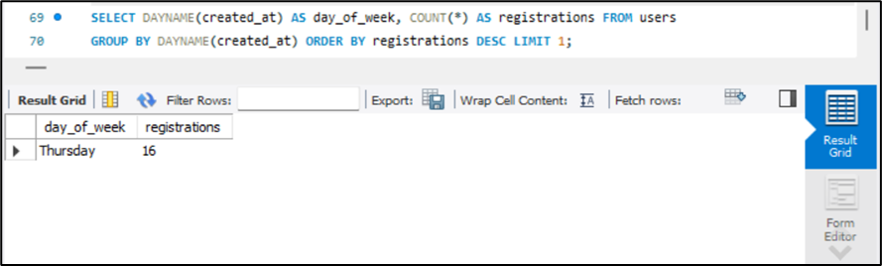
03
CONTEST WINNER DECLARATION: The team has organised a contest where the user with most likes on a single picture wins.
04
HASHTAG RESEARCH: A partner brand wants to know the most popular hashtags to use in their post to reach the most people.
.
INSIGHTS AND ANALYSES
05
AD CAMPAIGN LAUNCH: The team wants to know the best day of the week to launch ads.

Slide 11
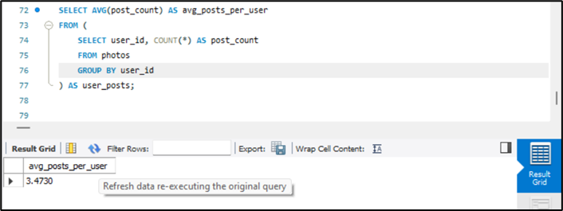
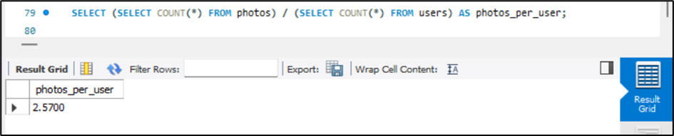
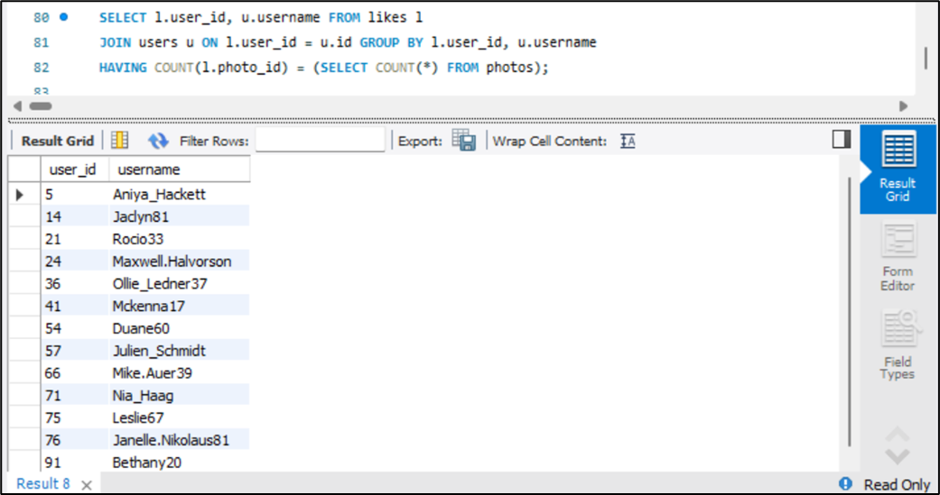
01
USER ENGAGEMENT: Investors want to know if users are still active and posting on Instagram or if they are making fewer posts.
INSIGHTS OF INVESTOR METRICS
02
Bots and Fake Accounts: Investors want to know if the platform is clouded with fake and dummy accounts.

Slide 12
ANALYSIS
MARKETING INSIGHTS
The five oldest users are Darby_Herzog, Emilio_Bernier52, Elenor88, Nicole71 and Jordyn.Jacobson2 .
There are no users which have been inactive.
The contest winner with most likes on a single photo is zack_Kemmer93 and total number of likes were 48.
The most commonly used hashtags are #smile, #beach, #party, #fun, #concert.
Most users register on Thrusday.
INVESTORS NSIGHTS
Active users post a photo 3.473 times i.e. they post an average 3-4 photos. If we consider all users then the value drops to 2.57 which ranges from 2-3 photos.
There are 13 fake accounts or bots.

Slide 13

CONCLUSION
By making this project, I have a better understanding of how to use SQL to cater to business needs. I have successfully achieved the tasks such as finding out most loyal users, inactive users and many more. I have also arrived at investors metrices like user engagement and bots and fake accounts which gives our investors an overall idea about the performance of Instagram.

Slide 14

OPERATION & METRIC ANANLYTICS
Operation Analytics is the analytics done for the complete end to end operations of a company. With the help of this, the company then finds the areas on which it must improve upon. Investigating metric spike is also an important part of the operation analytics as being data analyst.

Slide 15
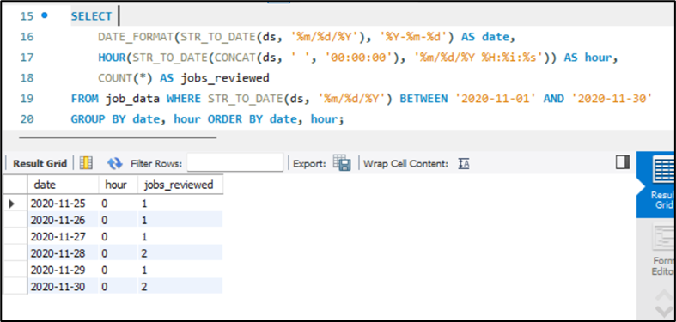
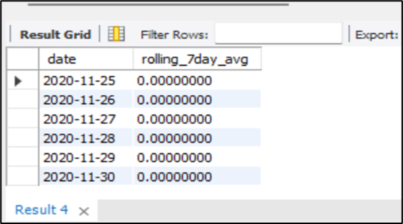
01
Jobs Reviewed Over Time: Calculate the number of jobs reviewed per hour for each day in November 2020.
INSIGHTS AND ANALYSES
Case study 1:-
02
Throughput Analysis: Calculate the 7-day rolling average of throughput (number of events per second).
.

Slide 16
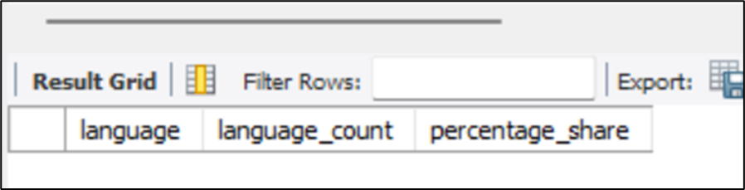
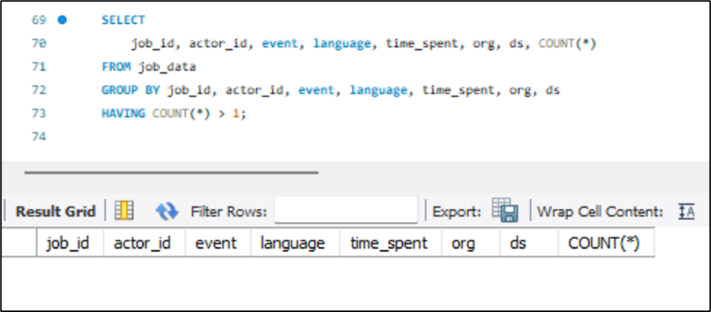
03
Language Share Analysis: Calculate the percentage share of each language in the last 30 days.
INSIGHTS AND ANALYSES
04
Duplicate Rows Detection: Identify duplicate rows in the data.

Slide 17
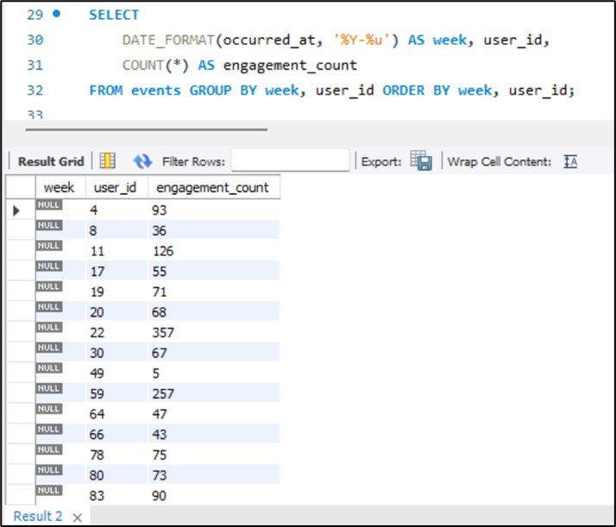
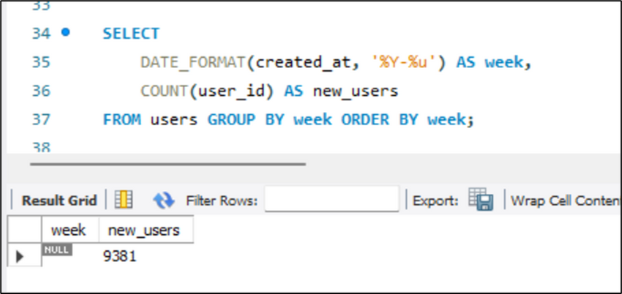
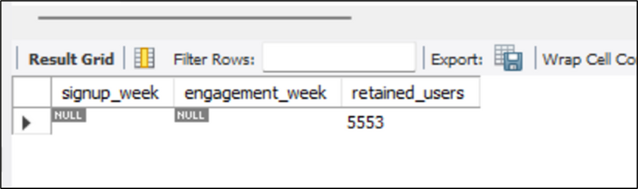
01
Weekly User Engagement: Measure the activeness of users on a weekly basis.
INSIGHTS AND ANALYSES
02
User Growth Analysis: Analyze the growth of users over time for a product.
.
Case study 2-
03
Weekly Retention Analysis: Analyze the retention of users on a weekly basis after signing up for a product

Slide 18
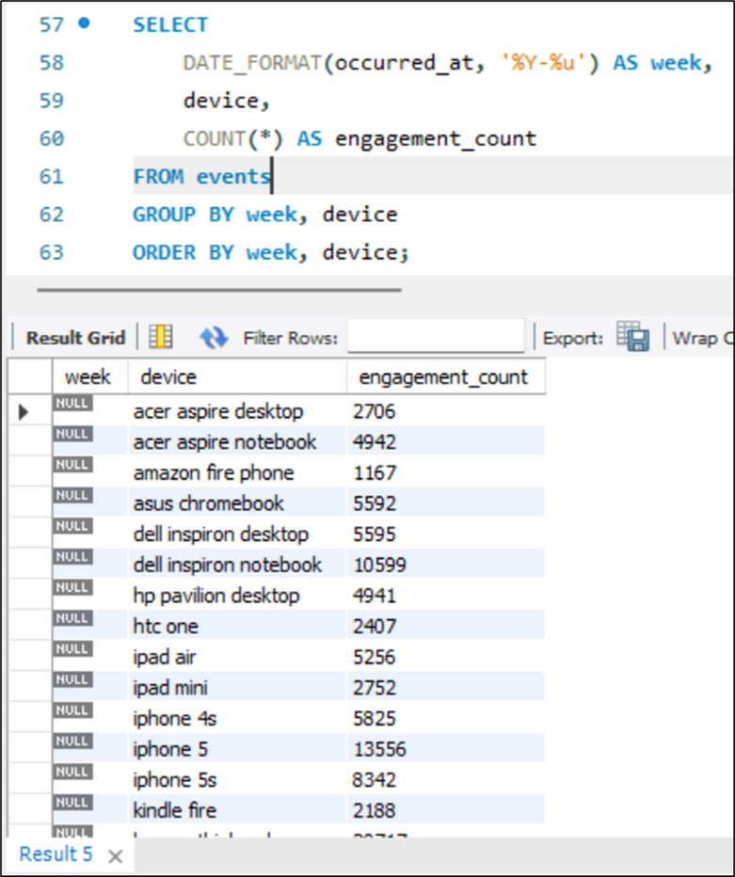
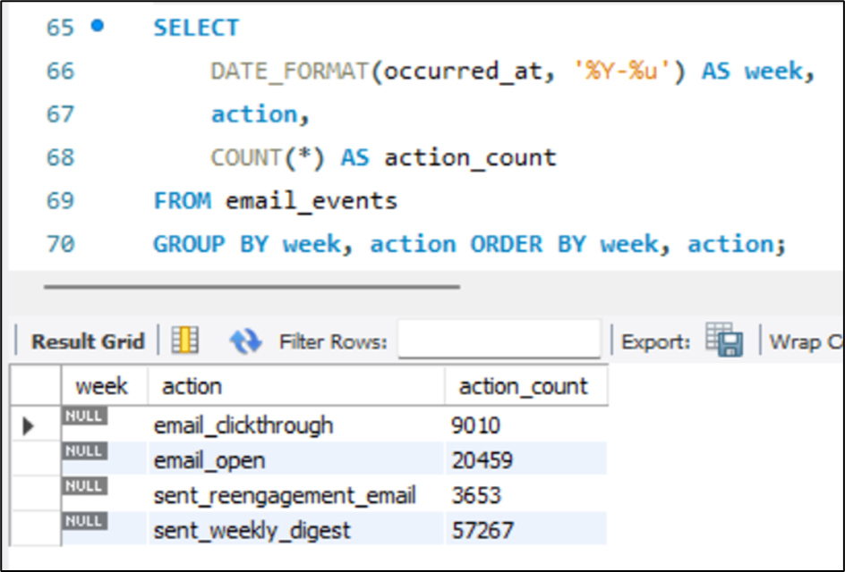
04
Weekly Engagement Per Device: Measure the activeness of users on a weekly basis per device.
INSIGHTS AND ANALYSES
05
Email Engagement Analysis: Analyze how users are engaging with the email service.

Slide 19
ANALYSIS
SQL helps in analysing huge data set effectively.
Weekly reports for high volume data can be easily generated using SQL.
CTE helps us to reuse sub-queries and makes queries easier to debug.
Window functions help us greatly in report generation.
We get a great idea about the performance and user trends of the product/ service by calculating the operational and investigating metrics.
This analysis helps us to understand the spikes and dips in each trend.
We can easily identify the areas we need, that need attention that is, areas that need improvement while studying the weekly reports.

Slide 20
CONCLUSION
By making this project, I have a better understanding how to use CTEs and window functions in SQL and how to generate various operational metrics to understand complete end to end operations of a company. For case study 1, on job data, I have successfully calculated various given tasks such as finding the number of jobs reviewed and throughput and many more. For case study 2, the Investigating metric spike has calculated to perform the given tasks such as Such as user engagement growth weekly retention and a few more

Slide 21

HIRING PROCESS ANALYTICS
Hiring process is the fundamental and the most important function of a company. Here, the MNCs get to know about the major underlying trends about the hiring process. Trends such as the number of rejection, number of interviews, types of jobs, vacancies etc. are important for a company to analyse before hiring freshers and any other individuals.

Slide 22
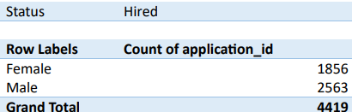
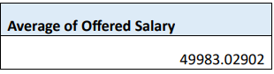
01
Male and female count
INSIGHTS AND ANALYSES
02
Average Salarty offered

Slide 23
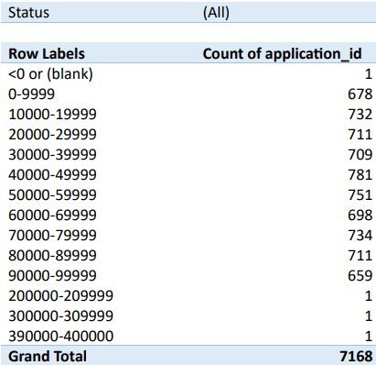
03
Salary class interval
INSIGHTS AND ANALYSES

Slide 24
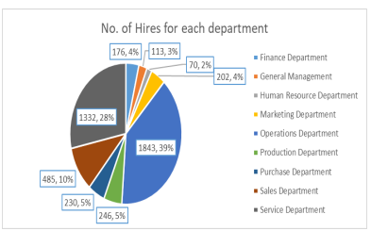
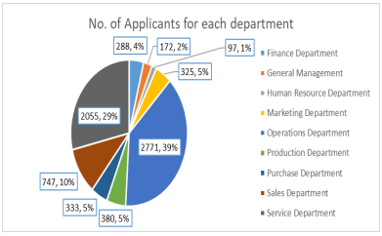
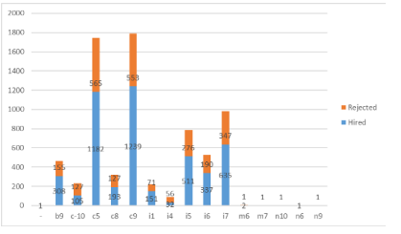
04
Department wise salary
INSIGHTS AND ANALYSES
05
Different post tiers

Slide 25
ANALYSIS
39.5% of members hired were females and 54.6% were males. And the remaining either didn't want to say or did not mention their gender
Average salary offered is. 49,983 .03
The lowest salary offered is rupees 100 and the highest salary offered is 4,00,000. Within 1,00,000 if we see for L of 10,000 there are about 6 February to 790 offers made in each class interval.Operations department and Service Department. Have the most number of applicants and hires.
Applicants and hires are the highest for the posts C 9 and C5.

Slide 26
CONCLUSION
From this project, I have been able to understand the hiring trends like gender ratio and offered salary distribution. I was able to understand and visualise the department wise and post wise data summary. On the technical aspect, I used various formula and functions and experienced how powerful pivot table and charts are to summarise and visualise data

Slide 27

IMDB MOVIE ANALYSIS
From this project, the dataset with various different columns was provided.
We will be performing data analysis on the dataset to gain various insights about the IMDB movies.

Slide 28
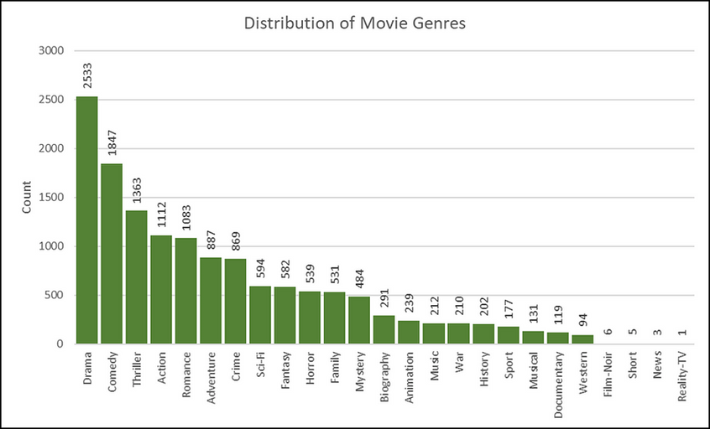
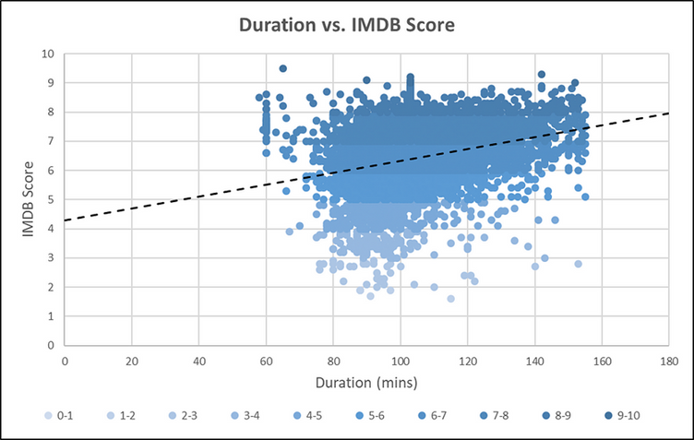
01
The top seven most common genres are :-
INSIGHTS AND ANALYSES
02
Movie duration and it’s impact on the IMDB score.

Slide 29
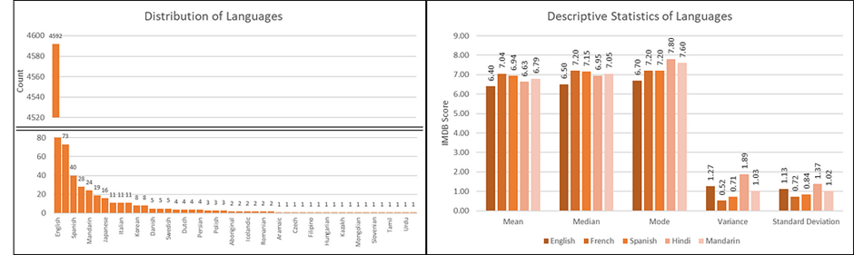
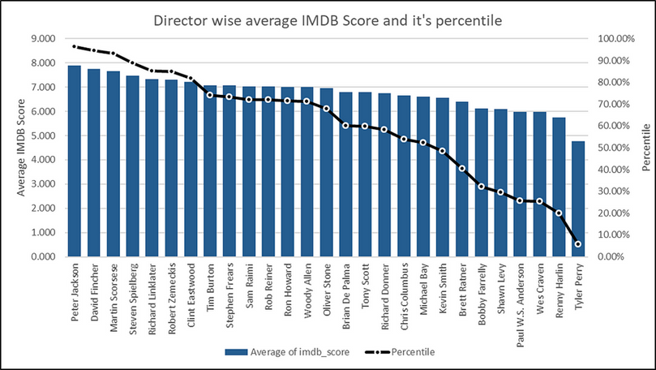
03
Most commonly used languages and it’s impact on the IMDB score.
INSIGHTS AND ANALYSES
04
Top directors on the basis of IMDB score and their contribuation for success of the movie.

Slide 30
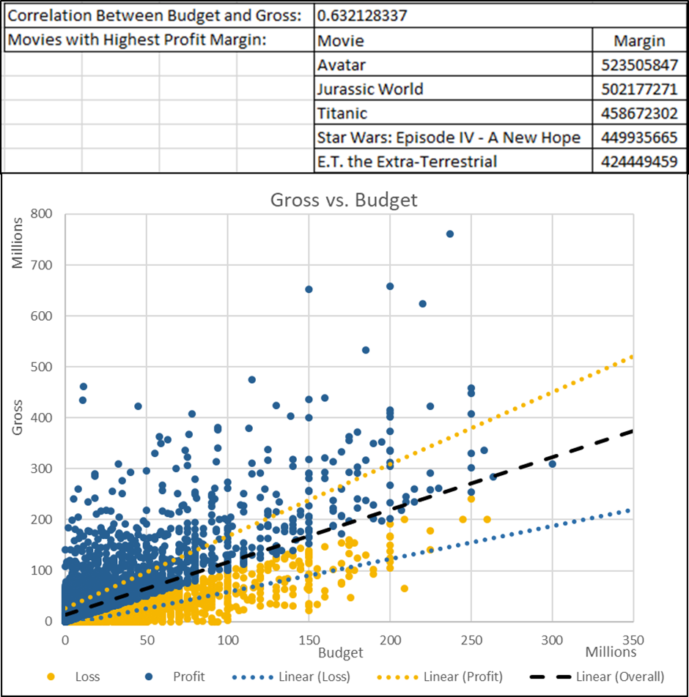
05
Relationalship between budget of the movie and financial success.
INSIGHTS AND ANALYSES

Slide 31
ANALYSIS
‘Avatar’ is the movie with the highest profit.
The movie ‘The Host’ faced enormous loss due to high budget and comparatively very low growth income.
Top five directors are :-
John Blanchard
Cary Bell
Mike Mayhall
Damien Chazelle
Charles Chaplin
The popular genre are :-
Action| Adventure| Crime| Drama| Sci-Fi| Thriller
Action| Adventure| Biography| Drama| History
Action| Drama| History| Thriller| War
Adventure| Animation| Drama| Family| musical
Crime| Drama| Fantasy| Mystery
The number of voted users have been exponentially increasing over the decades and faced a drop in 2010s.

Slide 32
CONCLUSION
I have successfully cleaned the data and found out the movies with the highest profit, Top 250 imdb movies best director popular genre and critic favourites, audiance favourite actors. I was able to understand how to use data analytics in real life scenarios and get answers to the real world problems. On the technical front, I was able to explore various functions and understand the utility and power of pivot tables and pivot charts.

Slide 33

BANK LOAN CASE STUDY
This case study aims to leave you an idea of applying EDA in real business scenario. In is the case study, apart from applying the techniques that I have learnt in the EDA module. I have also develop the basic understanding of risk analytics and banking service financials and understand how data is used to minimise the risk of losing money while lending to customers.

Slide 34
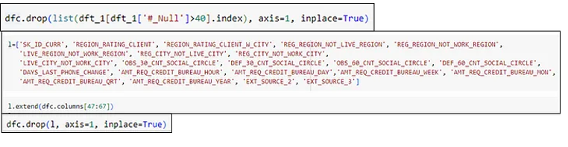
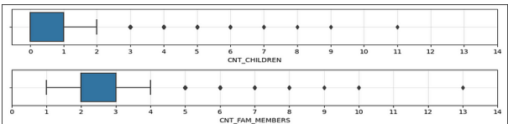
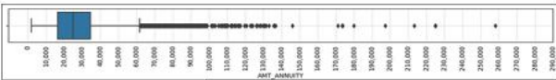
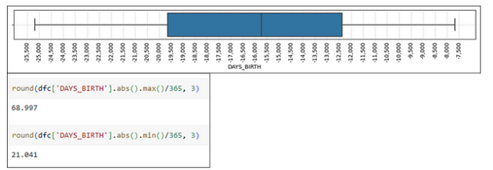
01
Finding missing values in dataset ‘APPLICATION.CSV’
02
Finding outliers in ‘APPLICATION.CSV’
INSIGHTS AND ANALYSES

Slide 35
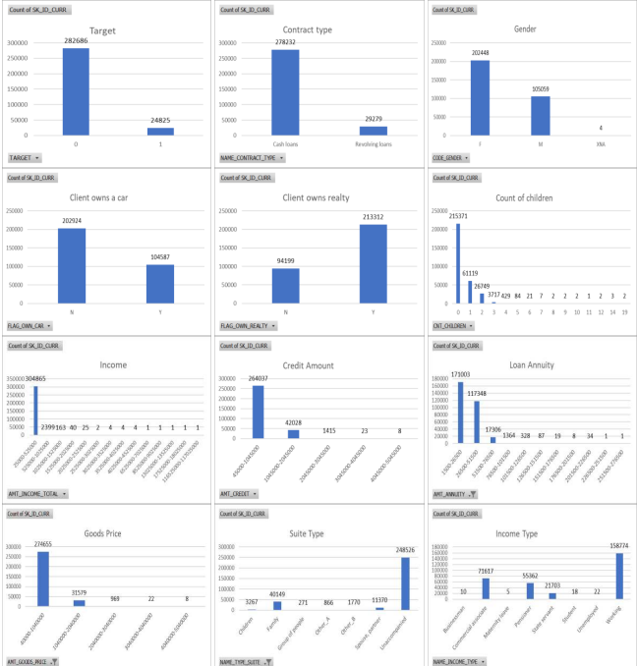
03
Ananlysing the data imbalance
UNIVARIATE ANALYSIS
INSIGHTS AND ANALYSES
04

Slide 36
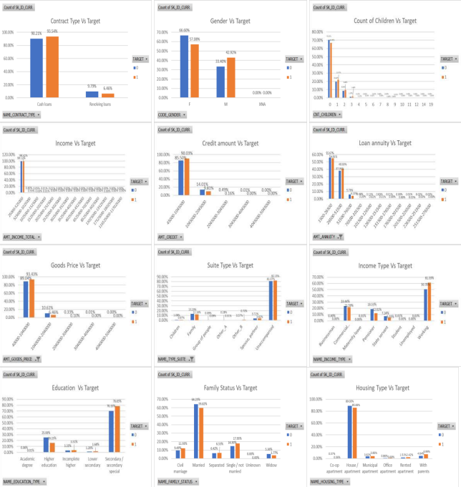
03
BIVARIATE ANALYSIS
INSIGHTS AND ANALYSES
04

Slide 37
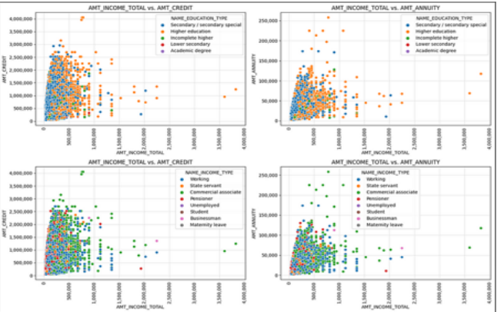
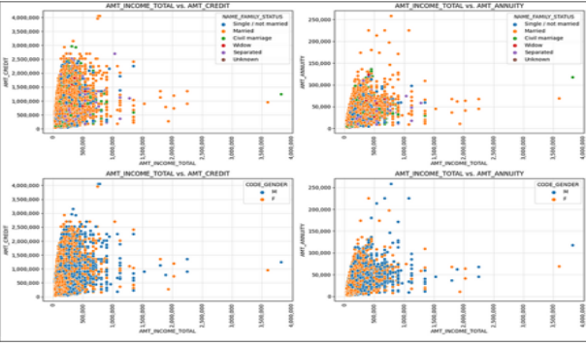
03
SEGMENTED UNIVARIATE ANALYSIS
INSIGHTS AND ANALYSES
04

Slide 38
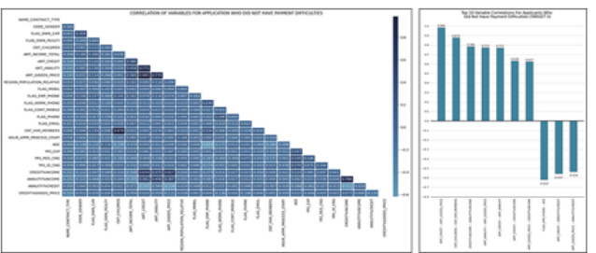
04
Top correlations for different scenarios:
INSIGHTS AND ANALYSES

Slide 39
ANALYSIS
Of all the applicants, only 8.07% of the clients have difficulty in payment.
There are various driving factors for loan defaults
Consumer attributes
loan attributes
Clients with high loan default tendencies are :-
having low income
clients living with parents
unemployed clients
clients with large family
clients from self employed and business entity organizations
early adulthood clients
single or not married clients
clients will rejected previous application
Clients with good loan payment capabilities are :-
have high income
clients with small family
clients owning reality
married
clients that are middle or late adulthood clients
clients who are pensioners, state servants and are on maternity leave
clients with improved previous applications

Slide 40
CONCLUSION
I have successfully performed risk analysis and gathered insights on loan payment and defaulters and their attributes. I was able to classify and profile the various kinds of clients who have applied for loans. I've also learnt to perform eda using Excel as well as using python.

Slide 41

IMPACT OF CAR FEATURES
The automotive industry has been rapidly evolving over the past few decades With a growing focus on fuel efficiency, environmental sustainability and technological innovation. With the increasing competition among manufacturers and a changing consumer landscape It has become more important than ever to understand the factors that drive consumer demand for cars. From the given data set, as a data analyst, the client has asked, how can a car manufacturer optimise pricing and product development decision to maximise profitability while meeting consumer demand? This problem can be approached by analysing the relationship between car features, market category, pricing and identifying which features and categories are most popular among consumers and most profitable to the manufacturers.

Slide 42
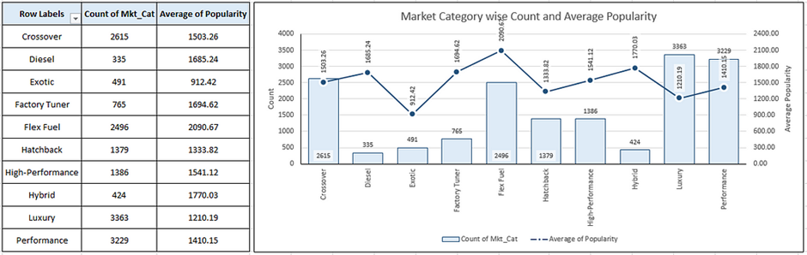
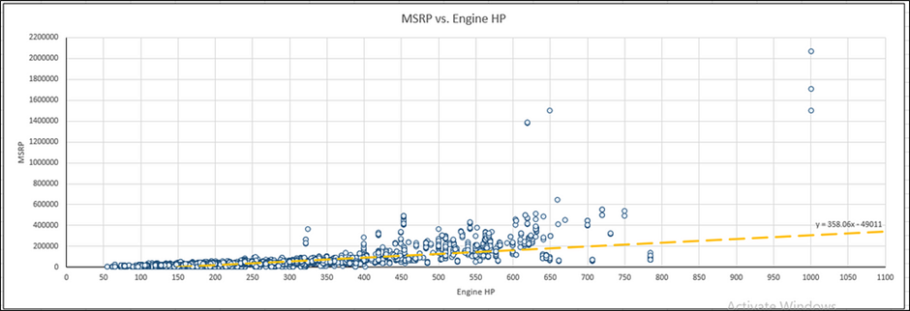
01
Popularity of car models varying differently across markets.
INSIGHTS AND ANALYSES
02
Relationship between car’s engine power and price.

Slide 43
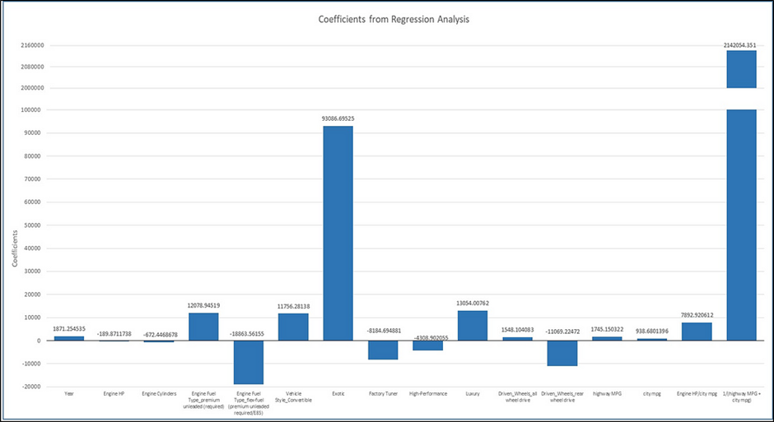
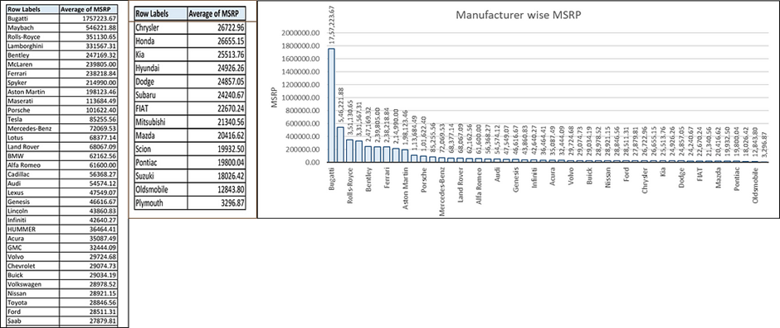
03
Car features used in determining a car’s price
INSIGHTS AND ANALYSES
04
How does the prices of cars vary accorss different manufactures

Slide 44
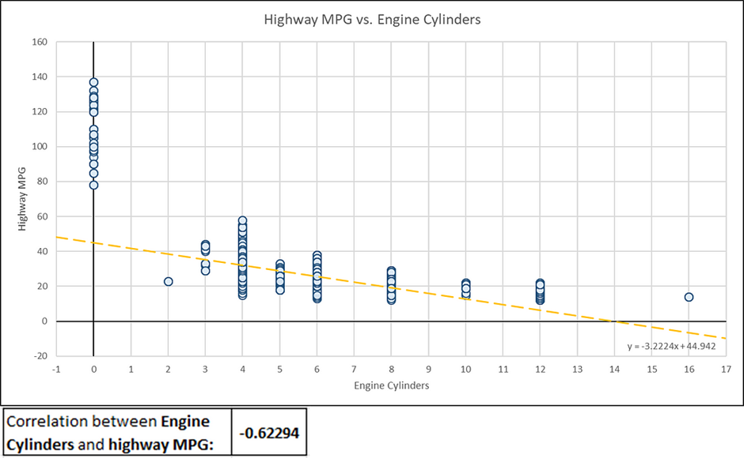
05
Relationship between fuel effiency and number of cyclinders in a car’s engine
INSIGHTS AND ANALYSES

Slide 45
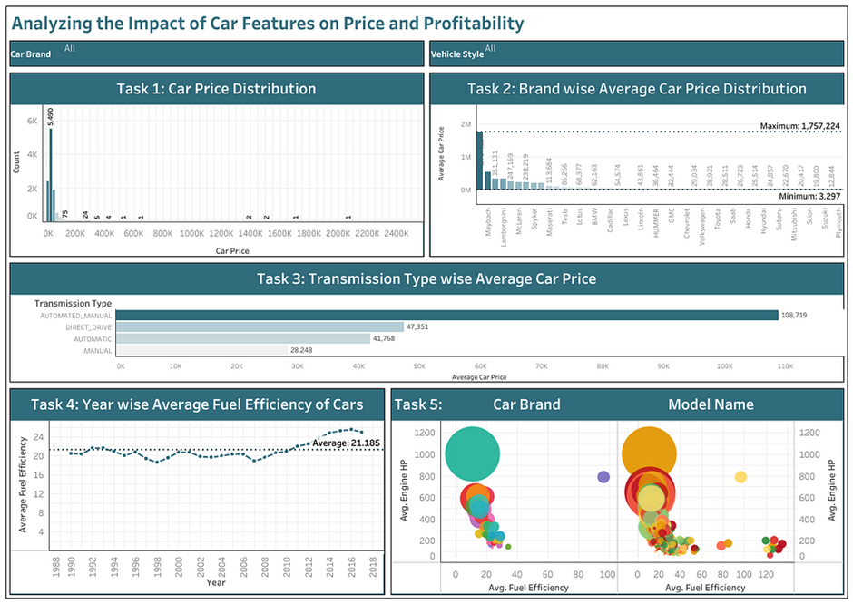
DASHBOARD

Slide 46
ANALYSIS
The popularity of car model varies drastically across different market categories. The most popular market categories are:-
hatchback and flex fuel
flex fuel and diesel
crossover, flex fuel and performance
Car engines power and its price have a position correlation in which they vary directly.
Car features, which are most important in determining cars price are :-
vehicle style
engine powerhouse
number of engine cylinders
engine fuel type
Fuel efficiency of cars have mostly been increasing over the years.
Automated manual cars have the highest average MSPR.
The fuel efficiency and the number of cylinders in the car's engine have a negative correlation that is as the number of cylinders increases. the fuel efficiency decreases.
Chevrolet has the highest sum of MSPR.
Casbah high engine horsepower seem to have lower MPG, however, they have higher average MSPR.

Slide 47
CONCLUSION
I have successfully completed all the tasks given and have answered all the questions. I was able to understand how to build an interactive dashboard which can be presented to management on the technical front. I was able to explore and utilise pivot tables and pivot charts, slicers and hyperlinks.

Slide 48

ABC CALL VOLUME TREND
A customer experience (CX) team consists of professionals who analyse customer feedback and data and share insights with the rest of the organisation. Typically, these teams fulfil various roles and responsibilities, such as customer experience programmes, digital customer experience, design and processes Internal communication and many more. In customer experience time, there is a huge employment opportunity for customer service representatives, aka calls center agents and customer service agents. Some of the most impactful AI powered customer experience tools can be used today such as Interactive voice response, Robotic process automation, Predictive analytics, Intelligent routing

Slide 49
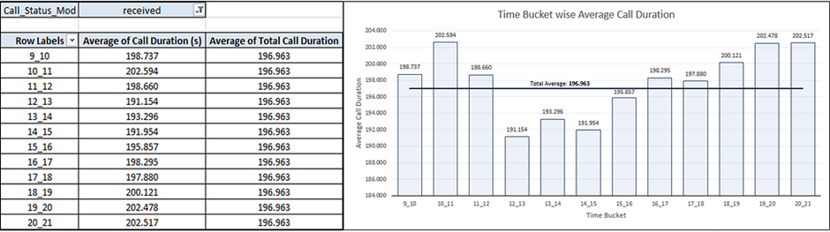
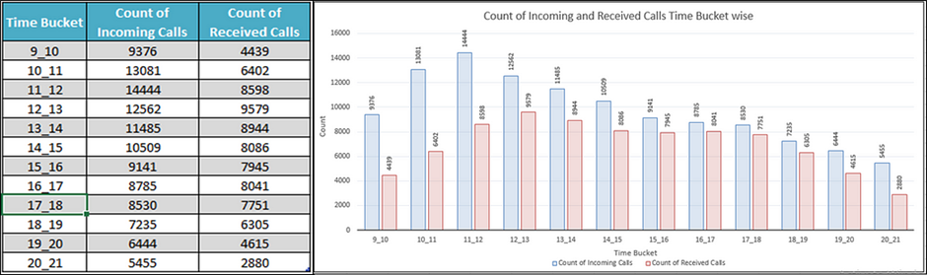
01
Average call duration for each bucket time
INSIGHTS AND ANALYSES
02
Call volume analysis

Slide 50
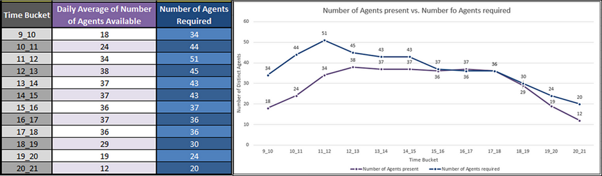
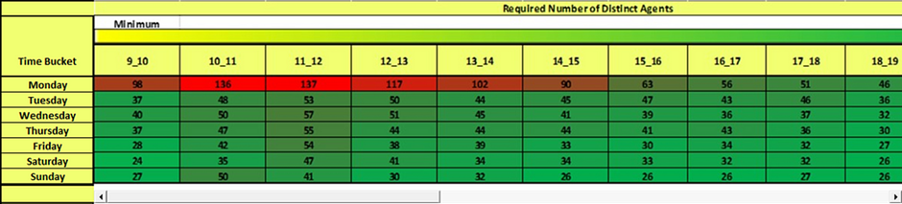
03
Minimum number of agents required in each time bucket to reduce the abandon rate to 10%
INSIGHTS AND ANALYSES
04
Manpower plan for each time bucket throughout the day, keeping the maximum abandon rate at 10%.

Slide 51
ANALYSIS
Average call duration of all incoming calls is lesser during 12:00 PM to 3:00 PM.
Call volume is higher in forenoon and afternoon that is between 10:00 AM to 3:00 PM.
Between 10:00 AM to 4:00 PM. manpower recruitment is high.
The minimum number of agents needed each day for 9 AM to 9:00 PM is 57 agents.
The minimum number of agents needed each day for nightshifts is 17 agents.
For nightshifts manpower requirement is higher between 6:00 AM to 9:00 AM.

Slide 52
CONCLUSION
We have successfully answered all the questions given. I was able nto come up with the manpower plan for day and night shift. On the technical front, I was able to explore and understand how calculations can be performed using various ways.

Slide 53


THANK YOU!

